Slide 1

MONGODB
BuG
HUNT

Slide 2
Preparing your tools for the hunt
MongoDB issue tracking (JIRA)
How to file a bug
How to test MongoDB
The hunting grounds - what's new in 3.4
The 3.4 schedule

Slide 3
MongoDB issue tracking (JIRA)
All MongoDB work is tracked through JIRA
https://jira.mongodb.org
SERVER, TOOLS, DOCS and DRIVERS projects are public
Need an account to create tickets and comment

Slide 4
The SERVER project
Used to track all server, shell, and mongos development
Open a ticket in this project if you find a bug
This project is not for questions
Use the mongodb-user group instead
https://groups.google.com/group/mongodb-user

Slide 5
Using JQL to navigate JIRA
Use JQL to find issues faster:
_project = SERVER and resolution is empty and summary ~ “collation"_
_project = DOCS and fixVersion = "mongodb-3.4" and resolution is empty_
_project = SERVER and affectsVersion >= 3.4.0-rc0 and resolution is empty_

Slide 6

How to file a bug
I've found a bug, what do I do now?

Slide 7
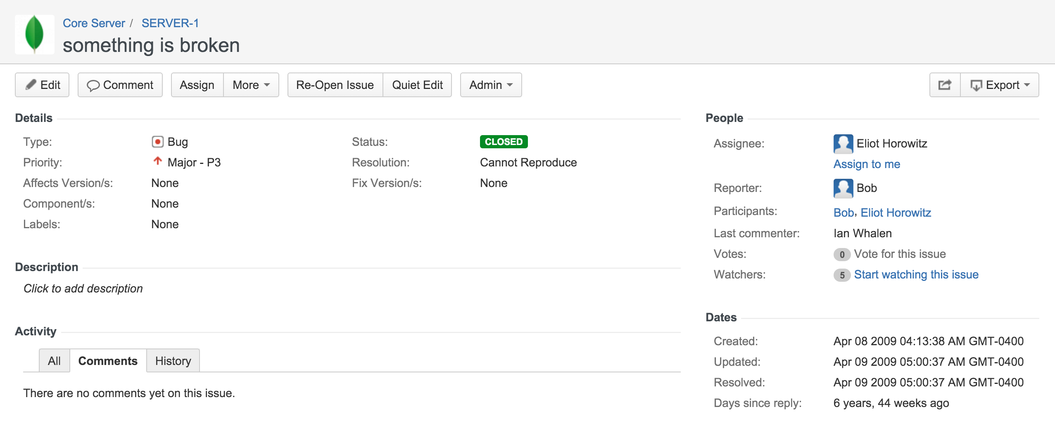

Preparing your tools for the hunt
Don’t do this
Or this

Slide 8
Try to answer these questions
WHAT
Slow queries, unexpected query results, etc.
WHERE
Primary, secondary, client application
WHEN
Specific times of the day, all the time, after an event
HOW MUCH
What's the impact and/or observable behavior

Slide 9
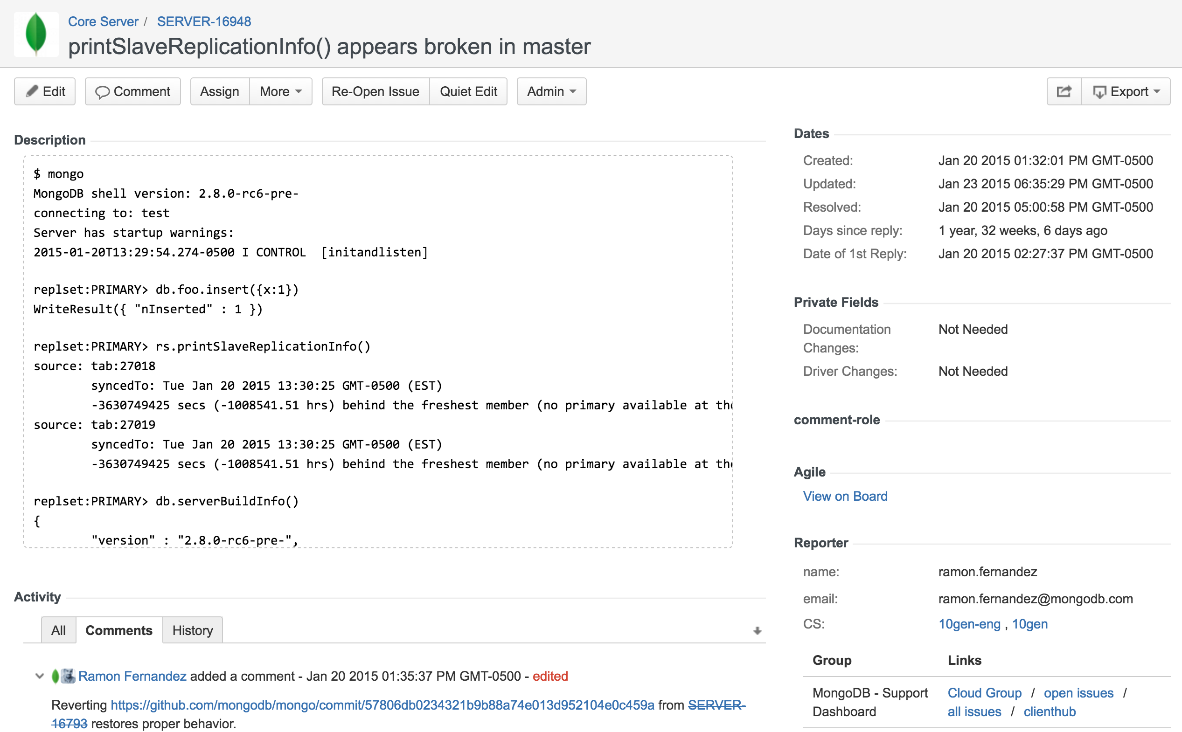
GOOD TICKEt!

Slide 10
What to include
A session transcript
A shell reproducer in JavaScript is best
A reproducer in other language helps too
Logs for all affected nodes
Contents of the diagnostic.data directory
MongoDB server/driver/platform versions

Slide 11
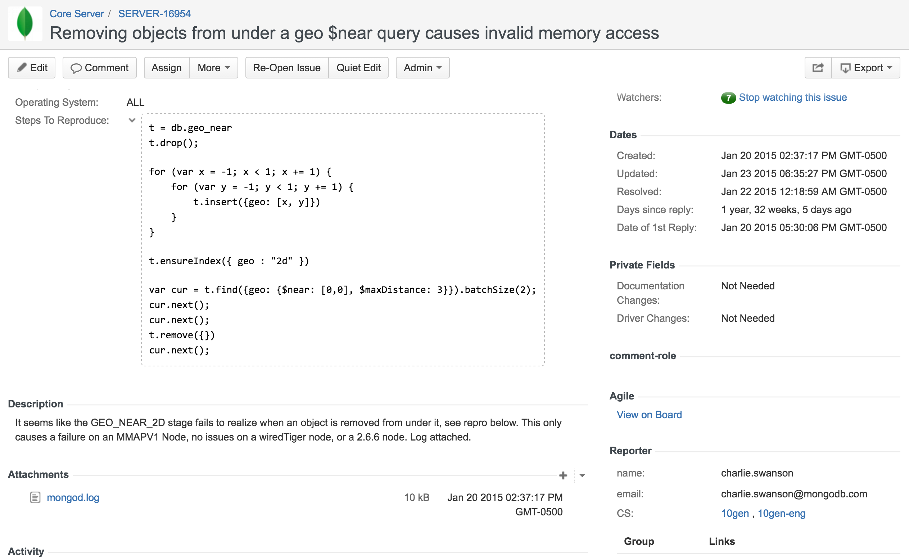
GOOD TICKEt!

Slide 12

Is this a bug?
MongoDB is full of surprises!
A certain behavior may be expected
Ask in the mongodb-user group
Same guidelines about asking good questions apply
A bug in the documentation is still a bug
File a detailed report in the DOCS project

Slide 13

Get Ready for the HUNT
Download the server
www.mongodb.com/download-center
Use 3.3.13, or the latest 3.4.0-rcN
Write your tests in a file
Use the shell
mongo < mytest.js

Slide 14
More advanced testing
Use an existing dataset
https://www.citibikenyc.com/system-data
Use mtools for more advanced setups
Replica sets
Sharded clusters
https://github.com/rueckstiess/mtools
See the jstests for black-belt testing
github.com/mongodb/mongo/tree/master/jstests

Slide 15

MongoDB 3.4

Slide 16
Tons of foundational work
Shard zones support
Faster auto-balancing
Intra-cluster compression
Robust initial sync
New architecture support

Slide 17
Lots of user-facing features
Read-only views
Graph lookup
Collation support
Decimal support
Aggregation improvements
Faceted search

Slide 18
The 3.4 schedule
MongoDB 3.4 is scheduled for publication before the end of the year
We'll be releasing "Release Candidates" until then
e.g.: 3.4.0-rc3
All bugs submitted between now and the 3.4.0 release are eligible to win the Bug Hunt
Amazing prizes await our fearless Bug Hunters!

Slide 19
Summary
The SERVER project tracks bugs and feature requests
SERVER, TOOLS, DOCS, DRIVERS
Help us help you: ask good questions
Easiest way to test is through the shell
Start with user-facing features

Slide 20
THE PRIZES
FIRST PRIZE
$1,500 Amazon Gift Card
Complimentary admission to MongoDB World or MongoDB Europe
2 Professional Certification exam vouchers
Recognition on our blog and in social media
Honorable Mentions
$500 Amazon Gift Card
Complimentary admission to MongoDB World or MongoDB Europe
1 Professional Certification exam voucher
Recognition on our blog and in social media

Slide 21
QUESTIONS?

Slide 22

RESOURCES
github.com/ramonfm/MUG201609
mongodb.com/download-center
docs.mongodb.com/manual/release-notes/3.3-dev-series/

